Slide 1
Unit Testing & Isolation
Testing Essentials, Testing Levels, Unit Testing, Mocking
SoftUni Team
Technical Trainers
Software University
http://softuni.bg

Slide 2
Table of Contents
Testing
Unit Testing
Mocking
Arrange
Act
Assert

Slide 3
Have a Question?
sli.do #java-web

Slide 4

Testing
Attention please!

Slide 5

Testing
Testing is an important part of the application lifecycle
In our ever-changing environment, testing is a necessity
New features need to be verified, before delivered to the clients
Testing is a wide area of application development
There are several levels of testing
It does not affect only programmers
It has many concepts of development
There are different types of testing

Slide 6

Unit Testing

Slide 7
Unit Testing
Unit Testing is:
A level of software testing where individual components are tested
The purpose is to validate that each unit performs as designed
The lowest level of software testing
Normally performed by software developers themselves
Often neglected, but it is in fact, the most important level of testing
Unit Testing is often isolated in order to ensure individual testing
Testing Frameworks often provide mocking functionality

Slide 8
Unit Testing - Mocking
Mocking – something made as an imitation
Mocking is a software practice, primarily used in Unit Testing
An object under test may have dependencies on other objects
To isolate the behavior, the other objects are replaced
The replacements are mocked objects
The mocked objects simulate the behavior of the real objects
Useful if the real objects are impractical / incorporate to the unit test
Basically, Mocking is creating objects that simulate behavior

Slide 9
Unit Testing - Benefits
Unit testing increases confidence in changing / maintaining code
Development is faster:
Verifying the correctness of new functionality is not manual
Localizing bugs, introduced in development is much faster
The cost of fixing a defect detected during Unit Testing is lesser
Compared to the cost of the bug if it reaches the clients
Debugging is easy
When a test fails, only the latest changes need to be checked
The code is modular and reusable (necessary for Unit testing)

Slide 10

Unit Testing a Web Application
Simple Demonstration

Slide 11
Unit Testing
Unit Testing web apps is pretty much like casual unit testing
Writing test methods to test classes and methods (functionalities)
Testing individual code components (units)
Independently from the infrastructure
You still use the same testing frameworks as in casual unit testing
When using a web frameworks such as Spring MVC
Built-in logic does not need to be tested
It is already tested during the development of the framework itself
You still need to test your custom functionality

Slide 12

Unit Testing
Testing a simple service with mocking in an Spring MVC app
@Entity
@Table(name = "users")
public class User {
private String id;
private String username;
private String password;
...
}
@Repository
public interface UserRepository extends JpaRepository<User, String> {
User findByUsername(String username);
}
public interface UserService {
User getUserByUsername(String username);
}
@Service
public interface UserServiceImpl {
...
public User getUserByUsername(String username) { return this.userRepository.findByUsername(username);
}
}

Slide 13
Unit Testing
Testing a simple service with mocking in an Spring MVC app
public class UserServiceTests {
private User testUser;
private UserRepository mockedUserRepository;
@Before
public void init() {
this.testUser = new User() {{
setId("SOME_UUID");
setUsername("Pesho");
setPassword("123");
}};
this.mockedUserRepository = Mockito.mock(UserRepository.class);
}
...
}

Slide 14
Unit Testing (Arrange)
Testing a simple service with mocking in an Spring MVC app
public class UserServiceTests {
...
@Test
public void userService_GetUserWithCorrectUsername_ShouldReturnCorrect() {
// Arrange
Mockito.when(this.mockedUserRepository
.findByUsername("Pesho"))
.thenReturn(this.testUser);
UserService userService = new UserServiceImpl(this.mockedUserRepository);
User expected = this.testUser;
...
}
}

Slide 15
Unit Testing (Act)
Testing a simple service with mocking in an Spring MVC app
public class UserServiceTests {
...
@Test
public void userService_GetUserWithCorrectUsername_ShouldReturnCorrect() {
...
// Act
User actual = userService.getUserByUsername("Pesho");
...
}
}

Slide 16
Unit Testing (Assert)
Testing a simple service with mocking in an Spring MVC app
public class UserServiceTests {
...
@Test
public void userService_GetUserWithCorrectUsername_ShouldReturnCorrect() {
...
// Assert
Assert.assertEquals("Broken...", expected.getId(), actual.getId());
Assert.assertEquals("Broken...", expected.getUsername(), actual.getUsername());
Assert.assertEquals("Broken...", expected.getPassword(), actual.getPassword());
}
}

Slide 17

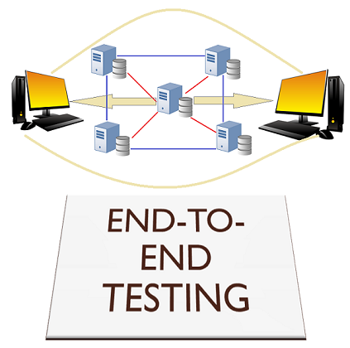

Testing
Web applications also need testing for "unintentional features"
Controllers, Services, Custom Components etc.
Different components of the application are tested differently
They are tested on different levels
Unit testing
Integration testing
End-to-End testing
Every component of the application must be tested

Slide 18
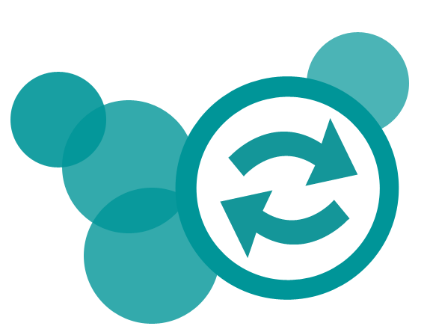
Testing
There are also different concepts and practices of test development
Code-first approach (The usual Development)
Test-first approach (Test-Driven Development)
Each has its own advantages and disadvantages
The Code-first approach ensures flexibility & fast development
The Code-first approach requires additional refactoring
The Test-first approach ensures quality and edge case coverage
The Test-first approach is complicated and is an "initial delay"

Slide 19
Testing
Some of the most common levels of Software Testing
Testing Level | Description
Unit Testing | Tests Individiual components of code, independent from the infrastructure
Component Testing | Testing of multiple functionalities (a single component)
Integration Testing | Testing of all integrated modules to verify the combined functionality
System Testing | Tests the system as a whole, once all the components are integrated
Regression Testing | Ensures that a fixed bug won't happen again
Acceptance Testing | Tests if the product meets the client’s requirements. Purely done by QAs
Load / Stress Testing | Test the application’s limits by attempting large data processing and introducting abnormal circumstances and conditions (edge cases)
Security Testing | Test if the application has any security flaws and vulnerabilities
Other Types of Testing | Manual, automation, UI, performance, black box, end-to-end testing, etc.

Slide 20
Testing
Why should we bother testing an application on different levels?
Isn’t Unit testing sufficient enough?
Unit testing ensures the correctness of a particular unit
Not testing all components, as a whole, may lead to false results
A single unit may function correctly, independent of the infrastructure
Combining components and testing them collectively is necessary
Every level of testing is essential to an application’s lifecycle
The questions above are easily answered by this image.

Slide 21

Testing
Why should we bother with Unit testing?
Can’t we just use Integration testing?..
Unit testing is essential!
Helps reduce the scope, when searching for errors
They run faster, they fail faster.
Unit tests are fast – you are more likely to run them frequently
Frequent checks ensure correctness of the functionality
Provide unit documentation (in a way)

Slide 22
Testing
Different Testing levels require different time and resources
Functional Tests (GUI)
* Developers & / QA
API Tests
* Developers & / QA
Integration Tests
* Developers
Components Tests
* Developers
Unit Tests
* Developers
Cost / Effort
Time

Slide 23
Testing
Live Demonstration

Slide 24


Summary
Testing is an important part of the application lifecycle
In our ever-changing environment, testing is a necessity
New features need to be verified, before delivered to the clients
Unit Testing is:
A level of software testing where individual components are tested
The purpose is to validate that each unit performs as designed
The lowest level of software testing

Slide 25
https://softuni.bg/trainings/courses

Slide 26













SoftUni Diamond Partners

Slide 27

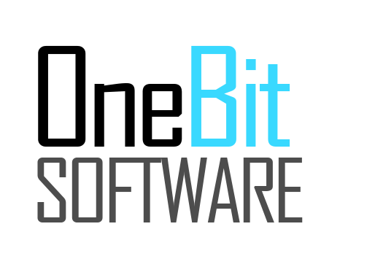



SoftUni Organizational Partners

Slide 28




Trainings @ Software University (SoftUni)
Software University – High-Quality Education and Employment Opportunities
softuni.bg
Software University Foundation
http://softuni.foundation/
Software University @ Facebook
facebook.com/SoftwareUniversity
Software University Forums
forum.softuni.bg

Slide 29

License
This course (slides, examples, demos, videos, homework, etc.) is licensed under the "Creative Commons Attribution-NonCommercial-ShareAlike 4.0 International" license

